Slide 1





Using Anchor Points to Define and Transfer Spatial Regions Based on Context
Matt Klenk
PARC
Nick Hawes
Kate Lockwood
Graham Horn
John Kelleher

Slide 2
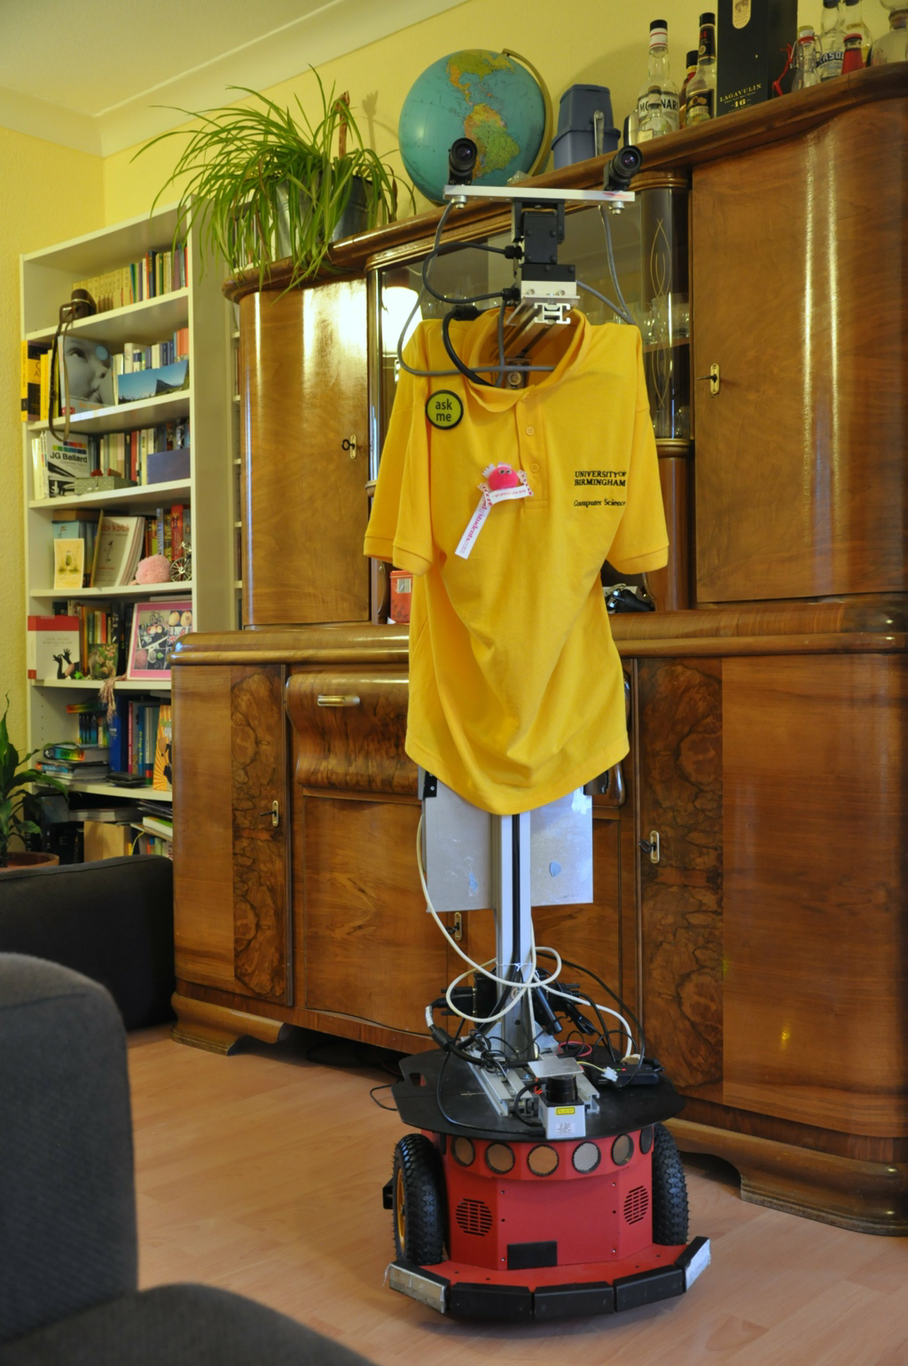

Slide 3
Context Dependent Spatial Regions
Environments are Defined by Context as well as Geometry

Slide 4
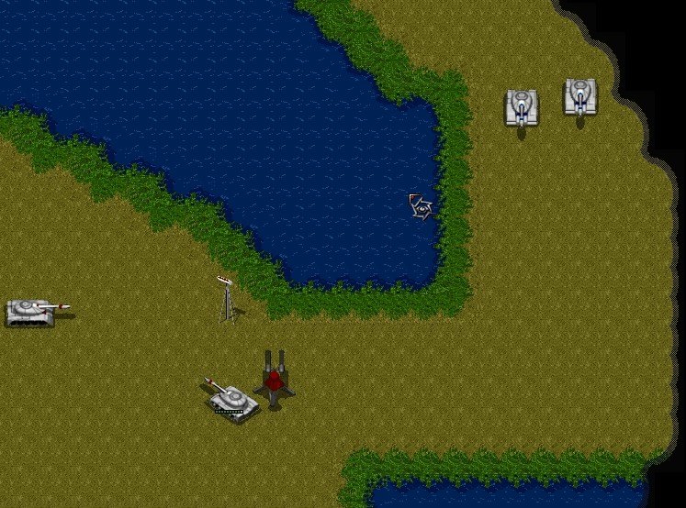
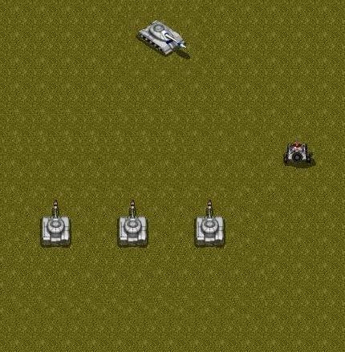

Slide 5


Slide 6


Slide 7


Slide 8


Slide 9
The Problem
From Sensor to Semantics
Increasing interest in the Robotics community
(e.g., Special Issue of Robotics and Autonomous Systems 2008, 2 AAAI-12 Workshops)
QR is all about making the relevant distinctions to solve problems
Why is this hard?
Integrate geometric, semantic, and relational reasoning

Slide 10
Cognitive Systems Solution
Qualitative spatial representations
RCC-8 + Positional relationships between entities
Symbolically describe context dependent spatial regions
Anchor points (Klenk et al. 2005)
Incremental learning from a single case
Analogy SME (Falkenhainer et al. 1989)

Slide 11
From Sensors to Symbols

Slide 14
Explore the classroom
Dora

Slide 16
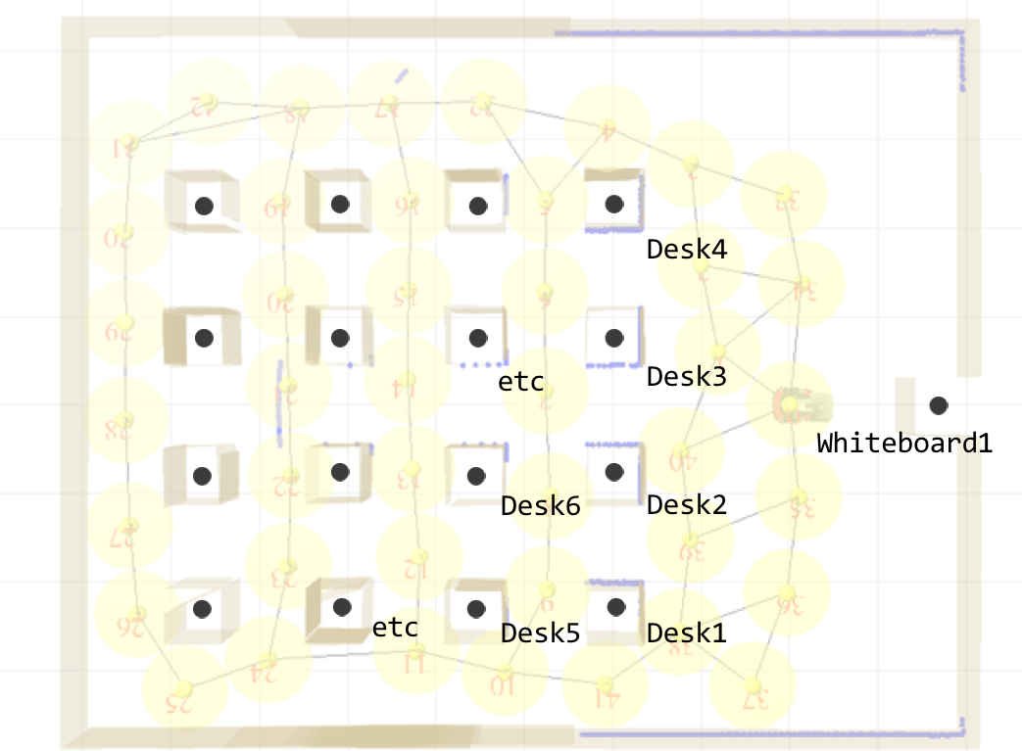

Slide 17
DeskGroup1
Create group entities for each set of adjacent objects with the same type

Slide 20

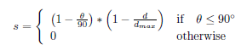
Qualitative Spatial Relationships
8 Positional Relationships
yMinusXZero (leftOf), yMinusXMinus (leftOfBelow)
Computed for each pair of adjacent objects
Measured in the global X, Y coordinates
Weighted to provide additional description
Strength map for points yPlusXZero (above)

Slide 21
Defining CDSRs with Anchor Points

Slide 22
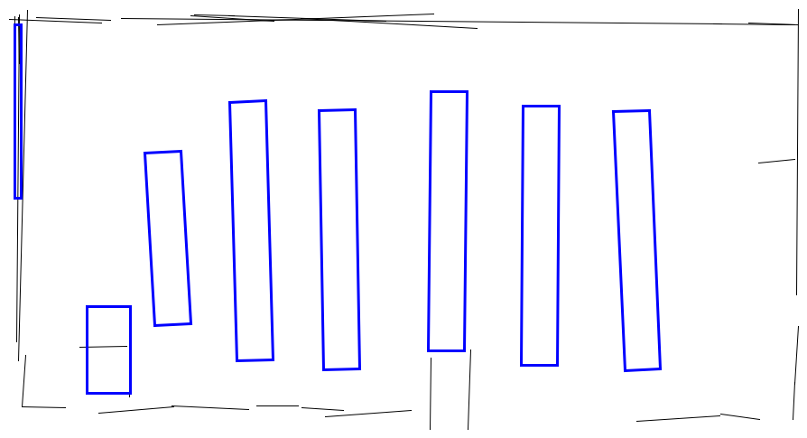
Anchor Points
Geometry from Classroom UG40
Link between perceived conceptual entities
CentroidFn
XMaxYMostFn
XMinYMostFn
YMaxXMostFn
…
(YMinXFewestFn Room1)
(XMinYFewestFn Room1)

Slide 23
Defining CDSRs with Anchor Points
(isa CDSR1 ContextDependentSpatialRegion)
(regionType CDSR1 FrontArea)
(regionBoundarySegment CDSR1
(XMinYFewestFn Room1)
(XMinYFewestFn Desk1))

Slide 24
Instance-Based Learning via Analogy

Slide 25
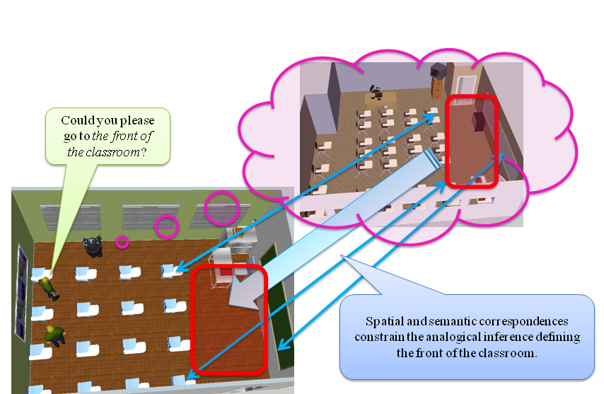
Goal

Slide 26
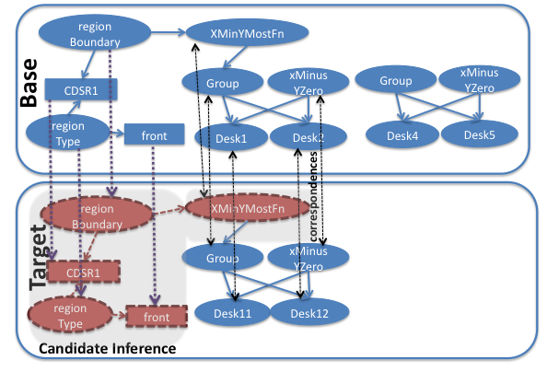
Analogical Inference

Slide 27
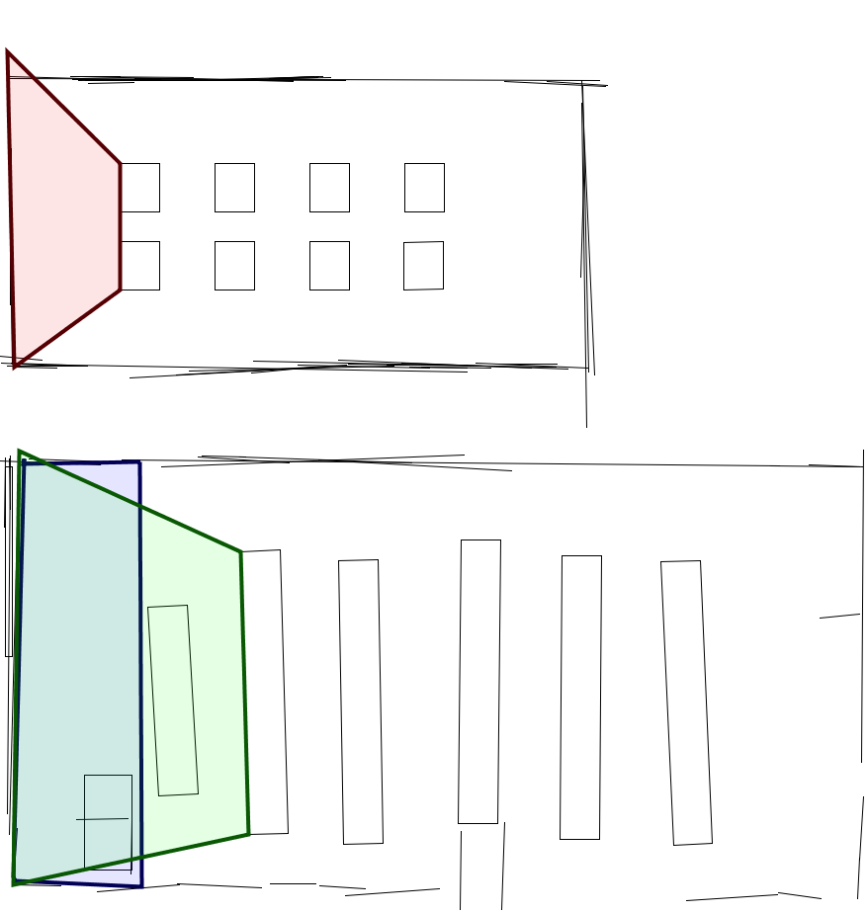
Manually encoded front of the classroom
Base
Human subject’s front of the classroom
Target
Analogically transferred front of the classroom

Slide 28
Experiment

Slide 29
Purpose
Are anchor points able to encode context dependent spatial regions?
Can we identify context dependent spatial regions by analogy with an understood example?

Slide 30
Materials
6 classrooms and 2 studio apartments
4 of the classrooms were real
4 regions per classroom, 3 regions per apartment
Manually encoded regions for each room
Ground truth from 3 human subjects

Slide 31
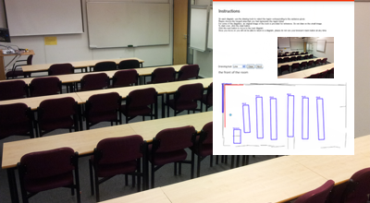
Subjects are asked to draw a polygon for the region of the front of the room
Geometric sensor data from the room in the picture.

Slide 32
Metrics

Slide 33
Results
Anchor points provide a reasonable representation for CDSRs
Anchor points enable the transfer of CDSRs

Slide 34
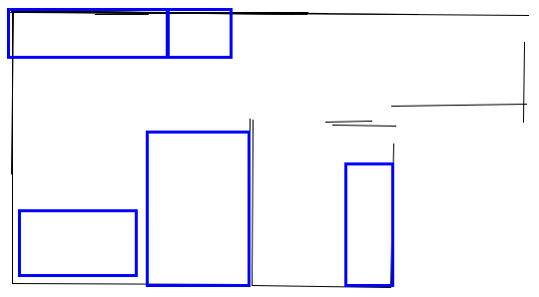
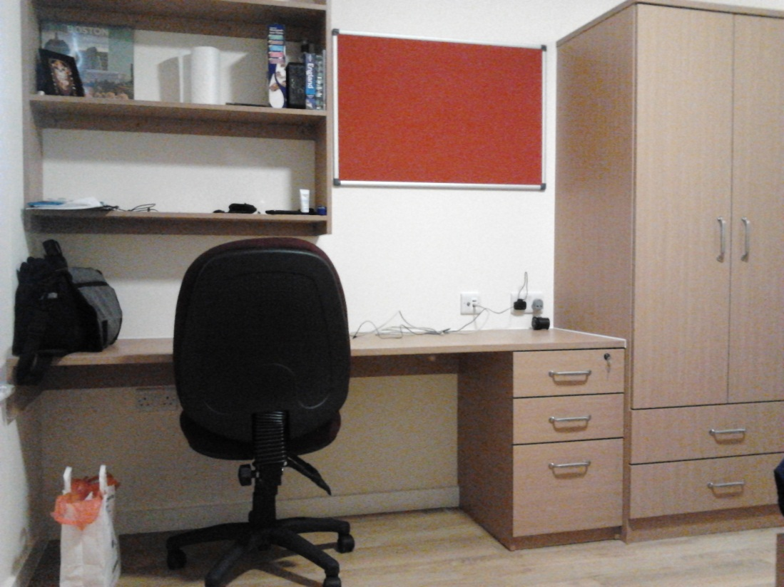
Failure Analysis
Desk, but what objects bound the office?
No anchor point for “near”?

Slide 35
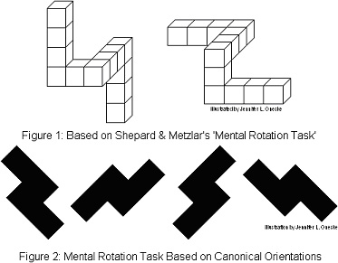
Current Limitations
Assumes same orientation
Future work: Qualitative rotations for best match
No anchor point for area “near”
Future work: Potential field models tied to anchor points
No transfer post-processing
Future work: compare the QSRs of the transferred region to that of the source region

Slide 36
Related Work
Mobile Robotics
Spatial Semantic Hierarchy
(Kuipers 2000)
Object search in human environments
(Pronobis 2011)
Analogy for spatial regions
NuSketch Battlespace
(Forbus et al. 2003)
Identification of geographic features
(McClure & Forbus 2012)

Slide 37
Discussion
Extract qualitative representations from sensors
Ground regions in sensor data using anchor points
Transfer context dependent spatial regions based on spatial and semantic similarity

Slide 38


Thank you
Questions?

Slide 39
Backup

